Slide 1
Chapter 04
Object Oriented Programming (SE 6022)
Packages and Interfaces

Slide 2
Objectives
After studying this chapter, students should be able to learn:
Packages
  Creating a Package
  Importing a Package
  Access Protection
Interfaces
  Creating an interface
  Using an interface

Slide 3
Introduction
A package is a container of classes and interfaces.
A package represents a directory that contains related group of classes and interfaces.
For example, when we write statements like: import java.io.*;
  Here we are importing classes of java.io package.
  Here, java is a directory name and io is another sub directory within it.
  The ‘*’ represents all the classes and interfaces of that io sub directory.
We can create our own packages called User-defined packages or extend the available packages, called Built-in packages.
User-defined packages can also be imported into other classes and used exactly in the same way as the built-in packages.
Packages provide reusability.

Slide 4
Creating a Package
Syntax for creating a package:
package packagename;
Ex: package pack;
The package creation statement must be the first statement in the program while creating a package.
And, declare all the members and the class itself as public
  then only the public members are available outside the package to other programs.
When the package statement is omitted, class names are put into the default package which has no name.

Slide 5
Package Hierarchy
To create a package hierarchy, separate each package name with a dot:
package myPackage1.myPackage2.myPackage3;
A package hierarchy must be stored accordingly in the file system:
  myPackage1\myPackage2\myPackage3
You cannot rename a package without renaming its directory!

Slide 6
Example – Creating a Package
//creating a package
package pack;
public class Addition
{ private double d1,d2;
public Addition(double a,double b)
{ d1 = a;
d2 = b;
}
public void sum()
{ System.out.println ("Sum is : " + (d1+d2) );
}
}
Compile: C:\OOP\javac –d . Addition.java
The –d option tells the Java compiler to create a separate directory and place the .class file in that directory (package).
The (.) dot after –d indicates that the package should be created in the current directory.

Slide 7
Accessing a Package
As packages are stored in directories, how does the Java run-time system know where to look for packages?
Two ways:
  The current directory is the default start point - if packages are stored in the current directory or sub-directories, they will be found.
  Specify a directory path or paths by setting the CLASSPATH environment variable.

Slide 8
CLASSPATH Variable
CLASSPATH - environment variable that points to the root directory of the system’s package hierarchy.
Several root directories may be specified in CLASSPATH,
Ex. the current directory and the C:\myJava directory:
.;C:\Lalaa\myJava
Java will search for the required packages by looking up subsequent directories described in the CLASSPATH variable.

Slide 9
Importing of Packages
Since classes within packages must be fully-qualified with their package names, it would be tedious to always type long dot-separated names.
The import statement allows to use classes or whole packages directly.
Importing of a concrete class:
import myPackage1.myPackage2.myClass;
Importing of all classes within a package:
import myPackage1.myPackage2.*;
The import statement occurs immediately after the package statement and before the class statement

Slide 10
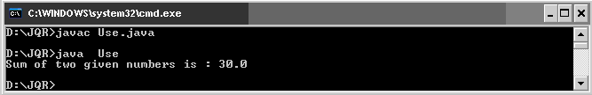
Example – Importing a Package
//Using the package pack
import pack.Addition;
class Use
{
public static void main(String args[])
{ Addition ob1 = new Addition(10,20);
ob1.sum();
}
}

Slide 11
Example- Adding a one more class to package
//Adding one more class to package pack:
package pack;
public class Subtraction
{ private double d1,d2;
public Subtraction(double a, double b)
{ d1 = a;
d2 = b;
}
public void difference()
{ System.out.println("Subtraction: " + (d1 - d2));
}
}

Slide 12
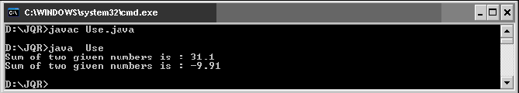
Example – Importing all classes
//To import all the classes and interfaces in a class using import pack.*;
import pack.*;
class Use
{ public static void main(String args[])
{ Addition ob1 = new Addition(10.5,20.6);
ob1.sum();
Subtraction ob2 = new Subtraction(30.2,40.11);
ob2.difference();
}
}

Slide 13
Creating sub package
We can create sub package in a package in the format:
package packagename.subpackagename;
Ex: package pack1.pack2;
Here, we are creating pack2 subpackage which is created inside pack1 package.
To use the classes and interfaces of pack2, we can write import statement as: import pack1.pack2;
//Creating a subpackage in a package
package pack1.pack2;
public class Sample
{ public void show ()
{
System.out.println ("Hello Java Learners");
}
}

Slide 14
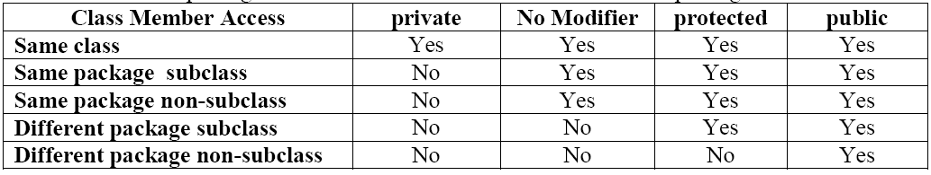
Access Protection
Specifies the scope of the data members, class and methods.
  private members of the class are available with in the class only. The scope of private members of the class is “CLASS SCOPE”.
  public members of the class are available anywhere . The scope of public members of the class is "GLOBAL SCOPE".
  default members of the class are available with in the class, outside the class and in its sub class of same package. It is not available outside the package. So the scope of default members of the class is "PACKAGE SCOPE".
  protected members of the class are available with in the class, outside the class and in its sub class of same package and also available to subclasses in different package also.

Slide 15
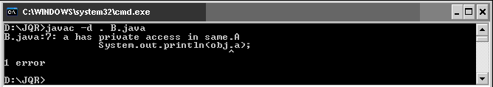
Access Specifiers - Example
//class A with different access specifiers
package same;
public class A
{ private int a=1;
public int b = 2;
protected int c = 3;
int d = 4;
}
//class B of same package, access the variables
package same;
import same.A;
public class B
{
public static void main(String args[])
{ A obj = new A();
System.out.println(obj.a);
System.out.println(obj.b);
System.out.println(obj.c);
System.out.println(obj.d);
}
}

Slide 16
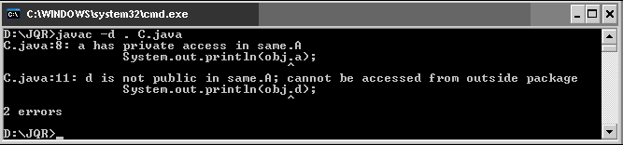
Contd.
package another;
import same.A;
public class C extends A
{ public static void main(String args[])
{ C obj = new C();
System.out.println(obj.a);
System.out.println(obj.b);
System.out.println(obj.c);
System.out.println(obj.d);
}
}

Slide 17
Interface
A programmer uses an abstract class when there are some common features shared by all the objects.
A programmer writes an interface when all the features have different implementations for different objects.
Interfaces are written when the programmer wants to leave the implementation to third party vendors.
An interface is a specification of method prototypes.
An interface contains zero or more abstract methods and all the methods of interface are public, abstract by default.

Slide 18
Contd.
An interface may contain variables which are by default public static final.
Once an interface is written any third party vendor can implement it.
All the methods of the interface should be implemented in its implementation classes.
If any one of the method is not implemented, then that implementation class should be declared as abstract.
We cannot create an object to an interface.
We can create a reference variable to an interface.
An interface cannot implement another interface.
An interface can extend another interface.
A class can implement multiple interfaces.

Slide 19
Defining an Interface
access-specifier interface-name
{
type final-varname1 = value;
type final-varname2 = value;
...
return-type method-name1(parameter-list);
return-type method-name2(parameter-list);
...
}
Access can be public or default
The methods which are declared have no bodies(abstract). They end with a semicolon after the parameter list.
Each class that includes an interface must implement all of the methods.

Slide 20
Contd.
To implement an interface, include the implements clause in a class definition, and then create the methods defined by the interface
access class classname [extends superclass][implements interface [,interface...]]
{
// class-body
}
access is either public or not used.
If a class implements more than one interface , the interfaces are separated with a comma.
If a class implements two interfaces that declare the same method, then the same method will be used by clients of either interface.

Slide 21
Example - Interface
interface Shape
{ void area ();
void volume ();
double pi = 3.14;
}
class Circle implements Shape
{ double r;
Circle (double radius)
{ r = radius;
}
public void area ()
{ System.out.println("Area of a circle is:" + pi*r*r );
}
public void volume ()
{ System.out.println("Volume of a circle is:" + 2*pi*r);
}
}

Slide 22
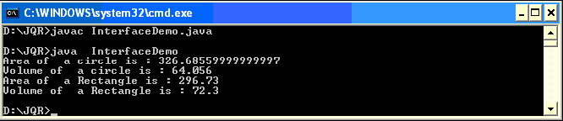
class Rectangle implements Shape
{ double l,b;
Rectangle (double length, double breadth)
{ l = length;
b = breadth;
}
public void area ()
{ System.out.println("Area of a Rectangle is: " + l*b );
}
public void volume ()
{ System.out.println("Volume of a Rectangle is:"+2*(l+b));
}
}
class InterfaceDemo
{ public static void main (String args[])
{ Circle ob1 = new Circle (10.2);
ob1.area ();
ob1.volume ();
Rectangle ob2 = new Rectangle (12.6, 23.55);
ob2.area ();
ob2.volume ();
}
}

Slide 23
Multiple Inheritance
Java does not support multiple inheritance. But it can be achieved by using interfaces.
interface Father
{ double PROPERTY = 10000;
double HEIGHT = 5.6;
}
interface Mother
{ double PROPERTY = 30000;
double HEIGHT = 5.4;
}
class MyClass implements Father, Mother
{ void show()
{ System.out.println("Total property is:" + (Father.PROPERTY+Mother.PROPERTY));
System.out.println("Average height is:"+ (Father.HEIGHT+ Mother.HEIGHT)/2);
}
}

Slide 24
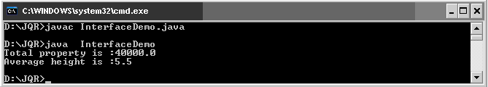
Contd.
class InterfaceDemo
{ public static void main(String args[])
{ MyClass ob1 = new MyClass();
ob1.show();
}
}

Slide 25
Some of Java's Most used Interfaces
Iterator
  To run through a collection of objects without knowing how the objects are stored, e.g., in array, list, bag, or set.
  More on this in the lecture on the Java collection library.
Cloneable
  To make a copy of an existing object via the clone() method on the class Object.
Serializable
  Pack a web of objects such that it can be send over a network or stored to disk. An naturally later be restored as a web of objects.
  More on this in the lecture on Java's I/O system
Comparable
  To make a total order on objects, e.g., 3, 56, 67, 879, 3422, 34234

Slide 26
Interface vs. Abstract Class
Interface
Abstract Class
Methods can be declared
No method bodies
“Constants” can be declared
Has no constructors
Multiple inheritance possible
Has no top interface
Multiple “parent” interfaces
Methods can be declared
Method bodies can be defined
All types of variables can be declared
Can have constructors
Multiple inheritance not possible
Always inherits from Object
Only one “parent” class

Slide 27
Self -Review Questions
What is a package? How do we design a package?
How do we add a class or interface to a package?
Explain in detail about accessing a package.
Explain about the access protection in packages?
What is interface? Write a program to demonstrate how interfaces can be extended.
Does Java Support multiple inheritance? Write Java a program to implement the multilevel Inheritance.

